Slide 1


Atfaluna
By
Mohamed Eldesoky
Abdulrahman El-Ghuff
Abedalrahman Rasem
Supervised By
Dr. Ammar Odeh

Slide 2

Introduction:
* Atfaluna is an application for smartphones.
* Helps to speed up communication with juvenile security centres.
* Available for all ages.
* Helps to increase the citizen's awareness of children's rights and duties.

Slide 3

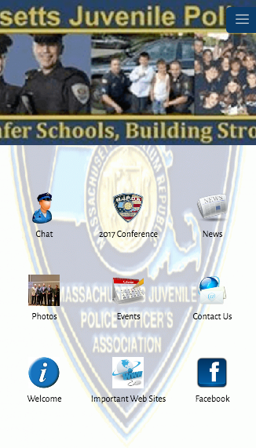
Literature Review
Massachusetts Juvenile Police System
This system allows other police, school administrators and other professionals that work with students to communicate together, as the Massachusetts Juvenile Police Officers Association has been in existence for a little over 50 years and has served also New England to keep students safer.
Overview of the System:
This system provides quite a bit of similarities with the Juvenile system we wish to design, Atfaulna, as it’s also a free app intended to bring adults, children and the people who could benefit from help regarding this topic in a way such that the System offers the following:
A – Contact Information
B – Chat/Report to the local police department
C – Important Sites/References
D – New & Updates for the user
The MJPS system offers basic, easy to access and navigate system as any simple, well-made Juvenile-Related system or application should have

Slide 4
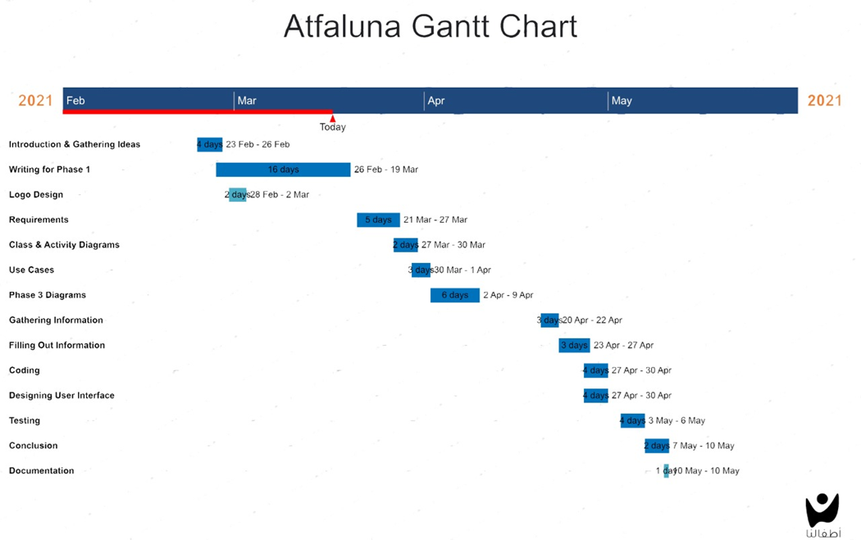

Slide 5
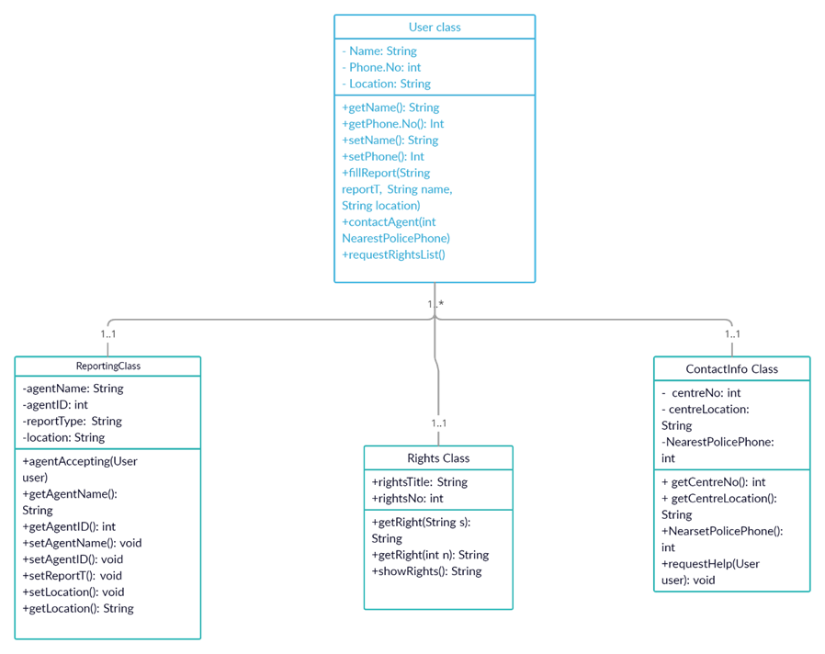
Class Diagram :

Slide 6
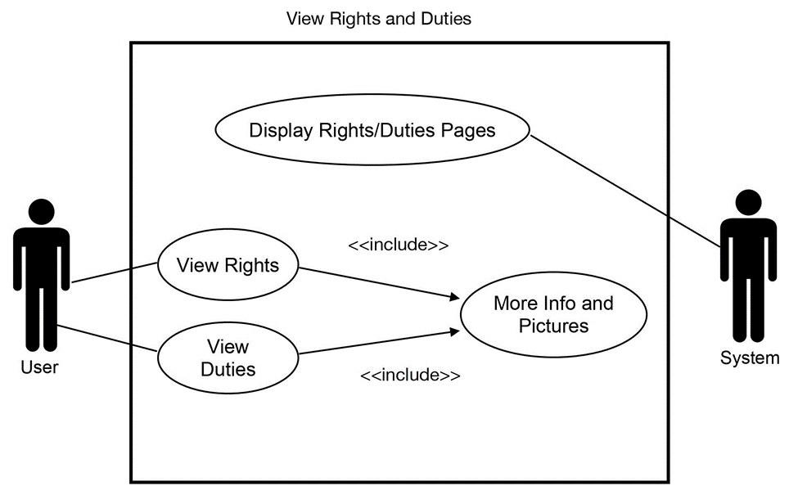
Use Case:

Slide 7
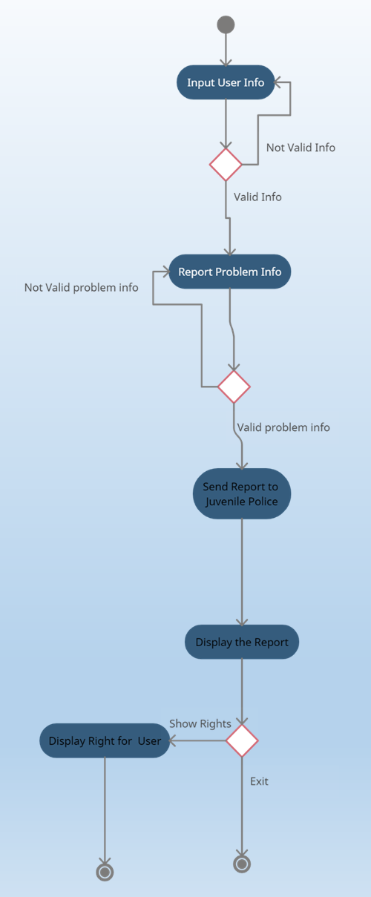
Activity Diagram:

Slide 8
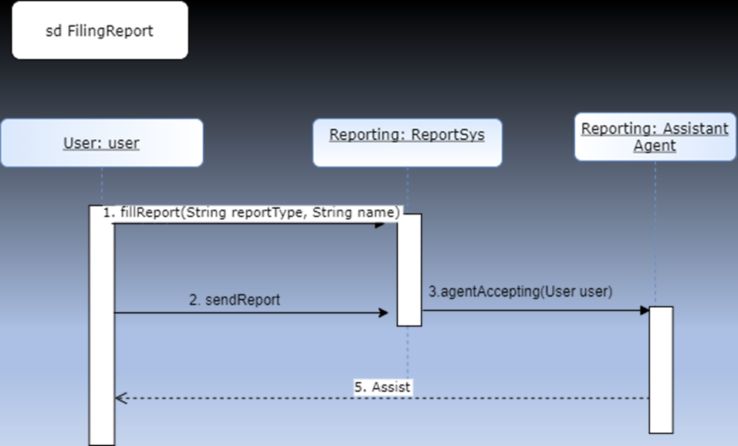
Sequence Diagram:

Slide 9

State machine Diagram:

Slide 10
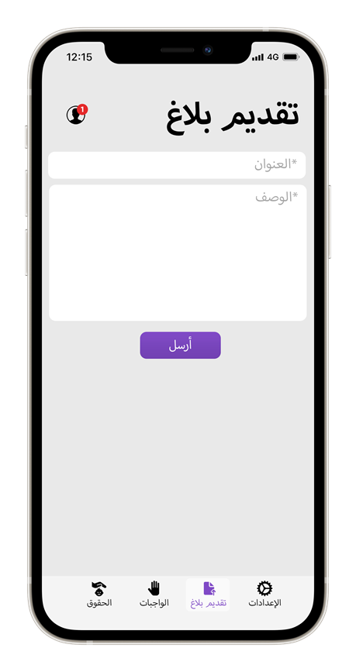
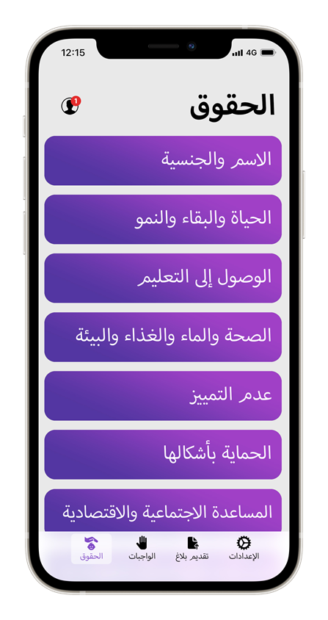
User Interfaces:

Slide 11
Future work:
In the future, we plan on adding more useful features, such as:
1- an AI system that automatically categorizes the type of the report using keywords from the description of the user’s report (violence, child labour, attack etc.),
2- a chatting system that enables users to ask about a specific problem,
3- a feedback tab to report bugs and issues or suggest a feature to developers,
4- a tab that shows success stories to encourage more reporting of juvenile-related issues and raise awareness about such issues, and an events tab to show upcoming events related to these issues.
Alongside adding more features, we would like to reach even more people using TV, social media, billboard advertisements, a dedicated website for desktop use, and online and face-to-face events.

